Slide 1
FY21 SHERM Metrics-Based Performance Summary
Key Performance Indicators for Safety, Health, Environment & Risk Management (SHERM):
Losses, Compliance, Finances, and Client Satisfaction

Slide 2
UTHealth Institutional Missions and SHERM’s Role, Contributions
UTHealth institutional missions:
Teaching
Research
Service
Service to the Institution (SHERM’s primary role)
4 Key Performance Indicators (KPI) of safety services provided
Service to the Community
SHERM also contributes to the other key institutional missions as well

Slide 3
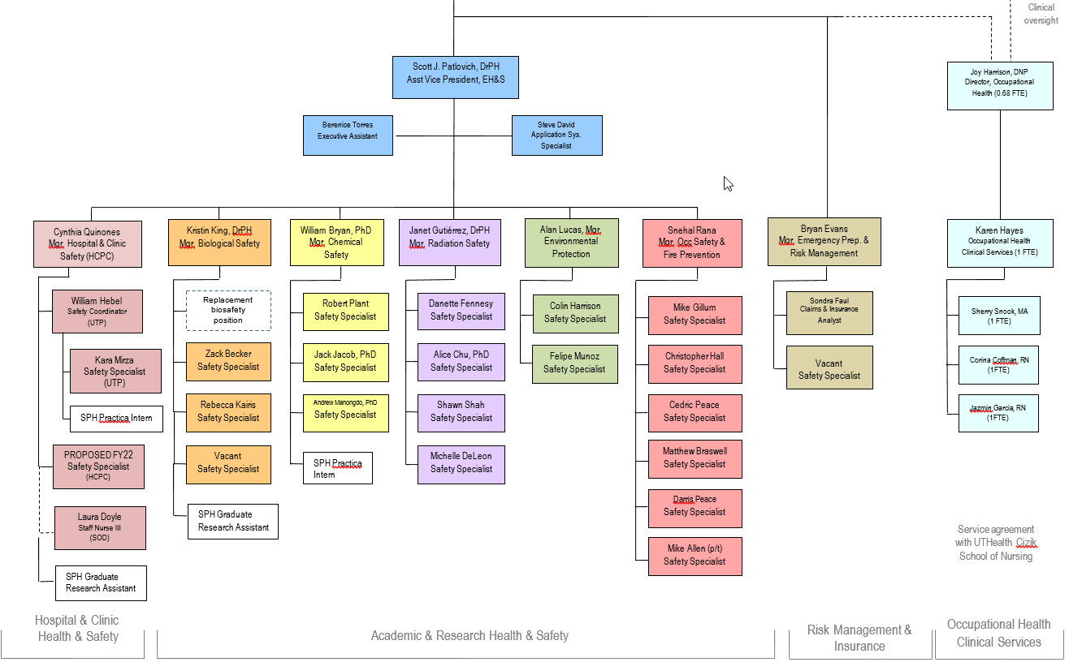
SHERM reports to the Executive Vice President & Chief Academic Officer
Safety, Health, Environment, &
Risk Management
Organizational Chart, November 2021
Robert Emery, DrPH
Vice President
SHERM
Other Appointments for Vice President Position:
Professor of Occupational Health, The University of Texas School of Public Health
Division of Epidemiology, Human Genetics and Environmental Sciences
Southwest Center for Occupational and Environmental Health
George Delclos, MD, PhD
UT Health Services Medical Director

Slide 4
Continued COVID-19 Pandemic Impacts
The COVID-19 pandemic has continued throughout FY21, therefore impacts to our departmental operations and services due to COVID-19 are specifically highlighted and addressed in this report
Many services continue to be dramatically increased
Normal operations and services are being continuously maintained
Some services remain reduced or continue to be deferred until a later time period
As essential personnel, SHERM staff have remained physically on campus during the entirety of FY21 to serve the institution
Despite the continued meritorious dedication and service to the institution, many SHERM staff have been affected personally and professionally by the pandemic. Therefore the health and wellness of our staff has been top priority and will remain so throughout FY22.

Slide 5
Notable SHERM Service During Ongoing Pandemic
Support provided for establishment and ongoing maintenance of COVID-19 vaccination hub initially at MSB, Cooley, and eventually UTPB
Receipt of all COVID-19 vaccine shipments to secure freezer storage location
Safety training provided during fully virtual new employee orientation sessions held by HR
Laboratory and clinic safety training courses, while traditionally provided in-person, have been shifted to fully virtual
Frequent on site consultations provided for schools, departments, and units returning to campus
Training regarding PPE use, particularity for employees and students interacting with patients during ongoing periods of widespread community transmission
Professional development and community based training sessions on COVID-19 precautions, vaccinations, etc.
Ongoing respiratory fit testing and training for over 4X normal volume of individuals
Collaboration with Office of Diversity and Equal Opportunity to evaluate COVID-19 precaution exemption requests
Frequent updates to campus signage regarding COVID-19 precautions as changes in precautions occur
Implementation of additional housekeeping disinfection and cleaning protocols
Participation on grants conducting COVID-19 related research and training (e.g. JETFIT, ECHO)
Continued increase in IBC protocol submittals and reviews
Provide support for creation of new Texas Epidemic Public Health Institute (TEPHI)
…and much, much more…

Slide 6
SHERM’s Four Key Performance Indicators (KPI) for Safety Services to the Institution
KPI #1 Losses
Personnel
Property
KPI #2 Compliance
With external agencies
With internal assessments
KPI #3 Finances
Expenditures
Revenues
KPI #4 Client Satisfaction
External clients served
Internal department staff

Slide 7
KPI #1: Losses
Personnel
Numbers of first reports of injury submitted by employees, residents, students
Number of reported employee injuries and illnesses requiring medical treatment
Workers’ Compensation Insurance experience modifier
Property
Losses incurred and covered by UTS Comprehensive Property Protection Program
Losses incurred but covered by outside party
Losses retained by UTHealth

Slide 9
Total Number of Employee First Reports of Injury and Subset of Compensable Claims Submitted to UT System, FY03 to FY21
Oversight by SHERM
Medical Residents transitioned
to become Employees
Number of reports with no medical claims
Number of reports with medical claims
*Increase in UTP clinics has resulted in greater risk of injury due to higher clinical injury exposures

Slide 10
Annual UTHealth Incidence Rate of Reported Employee Injuries and Illnesses Compared to National Hospital and University Rates (national data source: US Bureau of Labor Statistics)
Annual Reported Injury/Illness Rates
Hospitals
NAICS 622
Universities
NAICS 6113
UTHealth

Slide 11
Workers’ Compensation Insurance Premium Experience Modifier for UT System Health Institutions Fiscal Years 03 to 21 (premium rating based on a three year rolling average as compared to a baseline of 1.00)
Oversight by SHERM
Medical Residents transitioned
to become Employees
UTHSCT (0.163)
UTMB (0.120)
UTHSCSA (0.104)
UTSWMCD (.087)
UTHSCH (.064)
UTMDACC (0.040)
Fiscal Year

Slide 12
FY21 Retained Property Losses
Notable Retained Losses (inclusive of insurance deductibles)
Losses incurred and covered by third party
Auto-------------1/2021 $6,484
Losses incurred and covered by UTS insurance
Auto---------------12/2020 $7,776
Auto----------------1/2021 $35,649
Auto----------------1/2021 $15,605
Auto----------------8/2021 $5,861
Retained Loss Cost Summary by Peril
(Total FY21 retained losses = $1,145,451)
Type | Location | Date | Cost
Water | UPB | 12/27/20 | $48,500
Water | SPH | 2/8/21 | $47,467
Freeze | Various | 2/15/21 | $692,498
Water | SPH | 4/28/21 | $11,659
Water | BBS | 5/3/21 | $9,150
Fire | IMM | 5/17/21 | $58,846
Water | HMC | 6/1/21 | $69,273
Water | MSB | 6/3/21 | $5,309
Water | MSB | 6/6/21 | $9,972
Mold | BBS | 7/1/21 | $9,150
Water | CYF | 7/15/21 | $85,546
TOTAL |  |  | $1,145,451
Auto
Mold
Fire
Freeze

Slide 13
UTHealth Total Property Retained Loss Summary by Peril and Value, FY06 to FY21
Hurricane**
Freeze
Lightning/Fire*
Hurricane
Water
*FY15 – Lightning strike caused fire damage at student housing totaling $978K loss, with retained loss total at $417K
**FY17 – Hurricane Harvey losses totaling $12.6M, with retained loss total estimated at $4.8M

Slide 14
COVID-19 Impacts on Losses
Employees, residents, and students testing positive during COVID-19 pandemic impacting their ability to work or learn
Each case resulted in needs for contact investigations, disinfection/decontamination of work spaces, and lost work time during quarantine period
Total number of Supervisor’s First Reports of Injury forms submitted remained low overall during FY21 due to significant number of individuals working or learning remotely
Anticipating possible increase in Supervisor’s First Reports of Injury submissions due to individuals, departments, and units returning to campus for learning and work activities in FY22

Slide 15
Non-Routine Impacts from Losses
Winter Storm Uri brought unprecedented cold weather and snow/ice to the greater Houston area for multiple days in February 2021
Despite best preventative actions, many buildings sustained significant impairments from sustained freezing temperatures – primarily fire sprinkler system lines and domestic water lines bursting
Over $7 million in property damages across all UT System institutions
Retained loss of nearly $700,000 in total property damage sustained at UTHealth

Slide 16
Non-Routine Impacts from Losses
Primary SHERM office location within the Cyclotron Building sustained significant water damage from flooding event on July 15, 2021 caused by a faulty valve on chilled water line in mechanical room
All EHS personnel residing in this office location were temporarily relocated to swing space in the McGovern Medical School building for a three week time period
EHS services were maintained throughout despite these significant disruptions and damage to computers, various EHS equipment, and hazardous waste processing rooms
Retained loss of $85,000 in total property damage sustained
Preventative actions taken in advance of event, due to flood prone location from named storms, prevented more significant damage (e.g. storing equipment off of floors, etc.)

Slide 17
Non-Routine Impacts from Losses
Effective May 2021, the UT System Risk Management Advisory Committee membership agreed to increase the Comprehensive Property Protection Plan (CPPP) insurance deductible from $250K to $500K per occurrence in both the Fire / AOP and Wind / Flood Programs
Increase necessary due to extremely challenging insurance market conditions and to ensure long term financial stability of the property insurance plan
This is the first increase in deductible in almost 20 years
UTHealth will incur greater retained losses for each event and therefore prevention becomes even more paramount

Slide 18
FY22 Planned Actions - Losses
Personnel
Closely monitor increase in reported employee injury events (largely from the clinic setting) determine root cause and implement preventive measures
Evaluate slip, trip, and fall data to determine possible trends or locations; provide interventions to prevent recurrence where possible
Continue to focus on transition of medical residents who became employees on July 1, 2019 to contain costs associated with bloodborne pathogens exposures
Continue to support individuals as they “return to campus” during the COVID-19 pandemic situation to ensure health and safety of all campus stakeholders
Property
Re-emphasize focus on prevention and effective management of property insurance claims given recent increase in deductible from $250K to $500K per occurrence
Continue with successful efforts to educate faculty and staff about common perils causing losses (water, power interruption, and theft), simple interventions
Develop additional predictive methods for prompt recovery after losses occur, specifically estimated length of time to recovery
Continue to refine and improve oversight of UTP property loss prevention, mitigation, and insurance program

Slide 19
KPI #2: Compliance
With external agencies
Regulatory inspections; other compliance related inspections by outside entities
With internal assessments
Results of EH&S routine safety surveillance activities

Slide 20
External Agencies Inspections n= 5
 | Date | Agency | Findings | Status
1 | October 27-30, 2020 | AAALAC International | Suggested expansion of existing waste anesthetic gas monitoring program | Completed; ongoing monitoring program in place
2 | December 2, 2020 | Texas Department of State Health Services Radiation Control | No items of non-compliance (UTHealth, Dental Vans at OCB, X-ray R10908, Site 018, Remote) | Inspection file closed
3 | December 7, 2020 | Texas Department of State Health Services Radiation Control | No items of non-compliance (UT Physicians, Bayshore Multispecialty, X-ray R26367, Site 039, Unannounced) | Inspection file closed
4 | August 13, 2021 | Texas Department of State Health Services Radiation Control | No items on non-compliance (UTHealth, Broad License TMC Campus, License L02774, site 000, radioactive material use) | Inspection file closed
5 | August 13, 2021 | Texas Department of State Health Services Radiation Control | No items on non-compliance (UTHealth, Broad License TMC Campus, License L02774, site 000, physical protection / security) | Inspection file closed

Slide 21
Non-Routine External Compliance
Ensuring “normal” compliance measures remained in place during COVID-19 shutdown and ongoing pandemic situation
Adjusting operations to meet regulatory compliance variances issued by various regulatory authorities during COVID-19 shutdowns (e.g. oversight of radioactive materials; respiratory protection requirements due to severe global supply shortages such as reuse or reprocessing of protective equipment and temporary exemption from annual fit testing requirements; etc.)
Adaptation to new “virtual” or “hybrid” format utilized for regulatory inspections in lieu of onsite inspections during the COVID-19 pandemic
FY21 inspection frequency resulted in remarkable low number of total inspections, but during FY22 and beyond this should normalize to expected frequencies

Slide 22
Routine Internal Compliance Assessments
5,049 workplace assessments documented (increase from FY20, but still 19% lower than FY19 due to COVID-19 impacts)
Progression of routine surveillance program emphasis: labs, clinics, building fire systems, mechanical and non-lab spaces
1,710 deficiencies identified (70% in non-lab spaces)
806 of these deficiencies now corrected to date (represents a decreased efficiency in correcting deficiencies due to challenges of COVID-19 impacts)
EHS will continue to focus on assisting with correction of remaining 904 deficiencies
Some lab personnel not present onsite to help correct local issues
Clinical staff focused on COVID-19 issues and patient care as a priority
Working with FPE to track and report progress and reporting progress to appropriate safety committees
9,057 individuals provided with required safety training (increase of 30% compared to pre-COVID-19 conditions)
2,137 individuals trained and fit tested for respiratory protection (decrease from FY20 surge, but still 2X higher than pre-COVID-19 conditions)
Clinical based students (e.g. McGovern Medical School, Cizik School of Nursing, School of Dentistry) provided with COVID-19 awareness and PPE training
Continued increase in participation in online safety training modules (primarily refresher lab and clinic safety training)
Students accessing online safety training content in lieu of in-person training
As a result of software upgrades, there is now improved reporting of online safety training between EHS Assistant and HR Learning Management System (Learn 2 Succeed)
70% of PIs have submitted chemical inventories for filing in SHERM database

Slide 23
Non-Routine Internal Compliance
Continued oversight of medical residents who were onboarded as employees in FY20 which included termination of Texas Mutual WCI coverage and switching to UT System WCI oversight
Bloodborne pathogens exposures (e.g. needlesticks, etc.) remain most frequent type of injury experienced among this group
Water quality testing conducted in all UTHealth building locations following City of Houston water boil event due to Winter Storm Uri to ensure safety of water supply (February 2021)
Plan reviews, code compliance, and safety oversight of final TRB major construction projects at UCT, MSB, and SPH; oversight of final JJL renovations; oversight of new Dunn Behavioral Center construction project; design scope planning for TMC3 project

Slide 24
Non-Routine Internal Compliance
Ongoing COVID-19 related challenges:
Respiratory protection program compliance due to COVID-19 continues to require significant manpower and resources
2,137 individuals fit tested and trained by SHERM during FY21 (under normal circumstances average is 1,200 – 1,300 individuals)
Expedited medical evaluations to ensure fit testing – resources needed for Employee Health and Student Health to maintain this service going forward
Although UTHealth’s supply chain is robust at this time, some NIOSH-approved N95s still very difficult to obtain which creates challenges for some individuals
Sourcing and vetting of sufficient PPE remains essential, therefore the PPE and Supply Task Force led by the Office of Procurement continues to meet weekly with SHERM involvement and consultation
Requests for return to campus on-site consultations for academic, research, and clinical settings to ensure congruency with COVID-19 protocols to ensure health and safety of all occupants remains high
Stress among clinicians and research staff due to ongoing pandemic is significant, and therefore SHERM must remain cognizant and compassionate regarding these factors

Slide 25
FY22 Planned Actions - Compliance
External compliance
Continue to educate and prepare UTHealth & UTPhysicians clinics about State of Texas Radiation Control program who continue to conduct frequent unannounced x-ray inspections
Complete participation in NNSA program to decommission Cesium irradiators (X-ray irradiator alternative was purchased and installed in FY21 as part of this project)
Provide oversight of proposed withdrawal from Federal Select Agent program due to impending retirement of key faculty
Assist with the implementation of the new CMS and Federal Executive Order 14042 requirements for workplace safety protocols to protect individuals from COVID-19
Internal compliance
Develop efficiencies and strategy for long term management of respiratory protection program since demand remains high
Continue aggressive routine surveillance program. Incorporate lessons learned from deficiency data into safety training to prevent recurrence.
Focus on education of research and clinic personnel regarding controlled substances used and stored at UTHealth and UTP
Continue to work with FPE to systematically address identified deficiencies and support current projects to address fire safety considerations
Provide regular updates to appropriate safety committees
Continue emphasis on lab inventories of hazardous materials
Chemical inventories already a requirement
Support biosafety awareness and inventory of biological agents and toxins within UTHealth laboratories

Slide 26
KPI #3: Finances
Expenditures
Program cost, cost drivers
Revenues
Sources of revenue, amounts

Slide 27
Campus Square Footage, SHERM Resource Needs and Funding
(modeling not inclusive of resources provided for, or necessary for Employee Health Clinical Services Agreement)
Total Assignable Square Footage
and Research Subset
Modeled SHERM Resource Needs and Institutional Allocations
Research area (sf)
Amount Not Funded
Institutional Allocation
Non-research area (sf)
WCI RAP Rebate
Contracts & Training
Source: FPE, Space Management
Note: TNASF reported in FY18 & FY19 reduced due to accounting adjustment by FPE

Slide 28
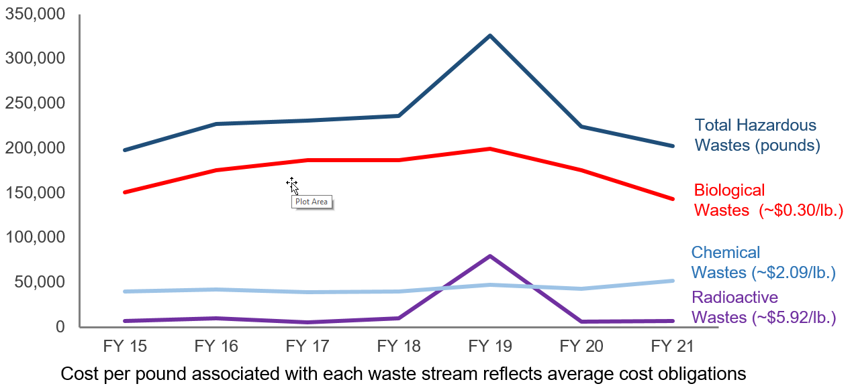
Annual Hazardous Wastes Volumes Generated (in pounds)
(inclusive of all Hazardous Biological, Chemical, and Radioactive Waste Streams)
Pounds
*Note: Increase in radioactive wastes in FY19 related to compulsory decommissioning of cyclotron unit

Slide 29
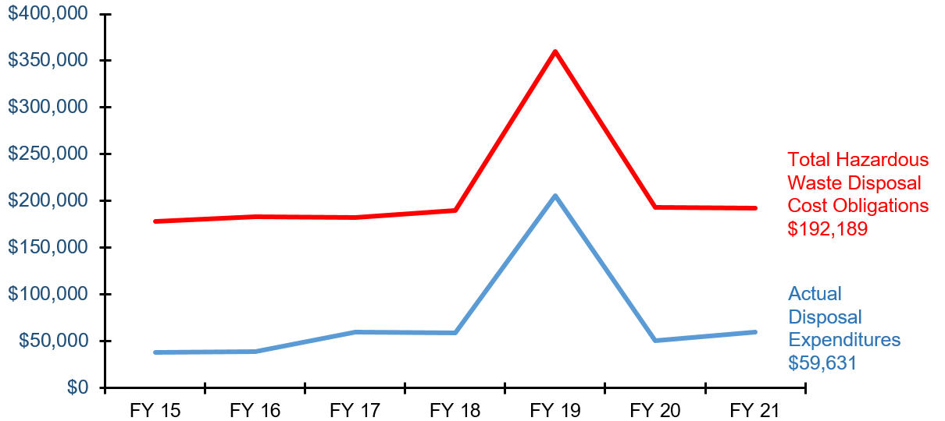
Hazardous Waste Cost Obligation and Actual Disposal Expenditures (Inclusive of Biological, Chemical, and Radioactive Wastes)
Note: Increase in hazardous waste costs in FY19 related to compulsory decommissioning of cyclotron unit
FY21 savings: $132,558

Slide 30
FY21 Revenues
Service contracts
UT Physicians $800,000
Note: Previous SHERM safety services contract for UTPhysicians was folded into the UTHealth/UTPhysicians MOU on Sept 1, 2020 at a rate of $800,000 per year. This amount includes $137,800 for Occupational Health Program.
Continuing education courses/outreach
Training, honoraria, peer reviews, $12,964
and fit testing for non-UTHealth personnel
SHERM staff salary offsets from various research grants $20,545
Total $833,509
NOTE: Above equates to 25% of total SHERM budget for FY21

Slide 31
Safety Support for UT Physicians
UTHealth / UTPhysicians MOU
Discontinued SHERM Professional Services Agreement and transitioned to UTHealth / UTPhysicians MOU at the request of UTHealth leadership on Sept 1, 2020
Combination of safety, insurance, and occupational health services under one contract
Current rate is now $800,000 annually for all services combined
Agreement includes services such as training, radiation safety permitting & surveys, general clinic surveys, fire & life safety surveillance, waste management, emergency preparedness & response, IAQ evaluations, asbestos/mold monitoring, accident/incident investigations, CAP/CLIA quality control monitoring, etc.
Recent activities
Added 1 FTE in Hospital & Clinic Safety Program to primarily assist with CAP/CLIA oversight and compliance, respiratory fit testing for clinicians, clinical safety surveys, etc.
1 FTE planned for Risk Management & Insurance Program to primarily assist with additional responsibilities related to loss prevention and insurance oversight for UTP, as well as to bolster emergency preparedness and management
Challenges
Continued growth and change of clinical locations and services
Tracking and managing all locations with radiation producing devices
Emergency management for UTP clinics in different geographic locations (spanning an area roughly the size of the state of Connecticut)

Slide 32
Current UTHealth / UTPhysicians Clinical Footprint
UTPhysicians Clinics:
UTP clinic locations (n=118)
UTP timeshare locations (currently ~30)
UTHealth Clinics:
UT Health Services Clinic (Employees and Medical Residents)
UT Student Health Services Clinic
SOD dental clinics (n=4)
Neurosciences (n=15)
WIC clinics (n=6)
Harris County Psychiatric Center + Dunn Behavioral Science Center

Slide 33
FY22 Planned Actions - Financial
Expenditures
Continue aggressive hazardous waste minimization program to contain hazardous waste disposal costs
Focus on regulated medical waste generation reduction in labs and clinics due to 30% increase experienced during recent (Sept 1, 2019) renewal of UT System-wide contract
Fees increase significantly each fiscal year for each point of collection, so primary focus is on minimizing volumes and maximizing efficiency to reduce stop frequencies
Continue to lobby for dedicated funding for Occupational Health Clinical Services Agreement because of impending discontinuance of UTS WCI RAP
Revenues
UTHealth / UTPhysicians MOU now includes occupational health allocation of $138,700
Continue with service contracts and community outreach activities that provide financial support to supplement institutional funding, including enhancing virtual training capabilities
Continue to participate in various research grant projects which allow for staff salary offsets
Continued receipt of WCI RAP fund allocations in FY21 ($160,721), but program may terminate at any point

Slide 34
FY22 Challenges - Financial
Current Financial Challenges
Continued support for high number of individuals participating in respiratory protection program due to COVID-19
Fit testing and training; sourcing of N95s and other PPE appropriate to protect workers and students from COVID-19 exposure
Continued increases in retained loss medical expenses due to transition of UT Medical Foundation residents to UT System workers compensation policy upon becoming UTHealth employees
Increase in property insurance deductible from $250K to $500K
Additional manpower needs to support continued clinical growth – planned additional FTE in FY22 to serve Dunn Behavioral Health Center once completed
Current shortfall in funding for Occupational Health Program
$450,000+ currently necessary to run program, increases anticipated due to recent medical resident transition
WCI RAP funds being used to support program, but these funds may not be issued again in future
$138,700 now coming from UTHealth / UTPhysicians MOU to help support Occupational Health Program

Slide 35
KPI #4: Client Satisfaction
External clients served
Results of Client Satisfaction Survey for Animal Care department
Internal department staff
Summary of ongoing staff professional development activities

Slide 36
Client Feedback
Focused assessment of a designated program aspect performed annually:
FY03 – Clients of Radiation Safety Program
FY04 – Overall Client Expectations and Fulfillment of Expectations
FY05 – Clients of Chemical Safety Program Services
FY06 – Clients of SHERM Administrative Support Staff Services
FY07 – Feedback from Employees and Supervisors Reporting Injuries
FY08 – Clients of Environmental Protection Program Services
FY09 – DMO/ASL Awareness Survey of Level of “Informed Risk”
FY10 – Clients of Biological Safety Program Services
FY11 – Feedback on new UTHealth Alert emergency notification system
FY13 – Clients of HCPC Safety Program Services
FY14 – Student Perception Survey question regarding safety program
FY15 – Clients of Occupational Safety & Fire Prevention program services
FY16 – Clients of HCPC Safety Program Services (re-evaluation of services since 2013 implementation)
FY17 – Area Safety Liaisons
FY18 – Clients of UTPhysicians Safety Program Services
FY19 – UTHealth Safety Committee Members (Institutional Biosafety, Chemical Safety, & Radiation Safety Committees)
FY20 – UT Police at Houston
FY21 – Center for Animal Medicine and Care

Slide 37
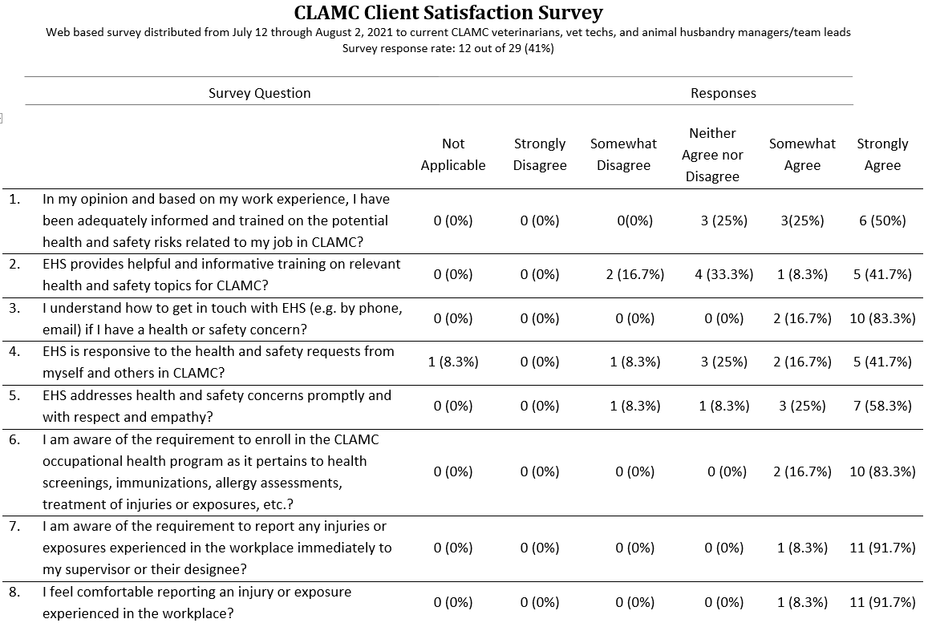
Client Satisfaction Survey (FY21)

Slide 38
Client Satisfaction Survey (FY21)

Slide 39
Internal Department Staff Satisfaction
Continued support of ongoing academic pursuits – leverage unique linkage with UT SPH for both staff development and research projects that benefit the institution
Weekly continuing education sessions on a wide variety of topics – conducted continuously via virtual format during COVID-19
“Safety Geek of the Week” staff recognition award for superior service delivery
Participation in the delivery of UT SPH continuing education course offerings
Participation in various UT SPH academic courses
Adjunct academic appointments in UT SPH EOHS department for doctorally-prepared staff (n=4)
Participation on several health and safety related grants through UT SPH
Membership, participation in professional organizations
Annual conduct of “SHERM Mentoring Day” where any interested staff member can meet with the VP SHERM to discuss professional development plans and seek advice, suggestions

Slide 40
FY22 Planned Actions – Client Satisfaction
External Clients
Continue with “customer service” approach to operations
Collect data for meaningful benchmarking to compare safety program staffing, resourcing, and outcomes
Interface with Student Services will be focus for FY22 survey
Internal Clients (departmental staff)
Continue with routine professional development seminars
Special focus on emerging issues: safety culture, insider threats, change management, technology in safety (digital safety), total worker health, cultural intelligence, communications, establishing relationships, understanding the exposome
Continue with involvement in training courses and outreach activities – continued focus on cross training
Continue mentoring sessions on academic activities
Continue 360º evaluations on supervisors to garner feedback from staff

Slide 41
Institutional Safety Service KPI Caveats
Important to remember what isn’t effectively captured by these metrics:
Increasing complexity of research projects supported
Increased collaborations and associated challenges
Increased complexity of regulatory environment
Impacts of construction – both navigation and reviews
The pain, suffering, apprehension associated with any injury – every dot on the graph is a person
The things that didn’t happen

Slide 42
SHERM Contribution to the Community Service Institutional Mission
Safety, insurance, and occupational health support to UT Physicians clinical operations
Staff membership on local safety committees:
Institutional Biosafety Committees (Rice University; University of Houston – Downtown )
Radiation Safety Committees (Memorial Hermann Hospital)
Delivery of professional continuing education courses through UT SPH
Participation in the leadership and management of professional associations by SHERM staff members
American Biological Safety Association – International
Inclusive of peer reviewed journal (Applied Biosafety) Editorial Board
Southern Biosafety Association (local affiliate of ABSA - International)
State of Texas Chapter of the Health Physics Society
American Academy of Health Physics
Outreach education through invited lectures provided to local and national professional organizations
Provision of subject matter expert interviews on safety-related topics to local and national media

Slide 43
SHERM Contribution to the Teaching Institutional Mission
UT SPH academic instruction, student advising
Several SHERM employees serve in adjunct faculty positions at SPH
Guest lectures at other UTHealth schools (UT MS and GSBS) and other area institutions (TAMU, TWU, TSU, UHCL, UHD)
Host student internships, practica. Advising for UT MS Scholarly Concentration students
Continuing education courses through UT SPH
Outreach education through courses with professional organizations (HPS, ABSA, CSHEMA, Eagleson Institute)

Slide 44
SHERM Contribution to the Research Institutional Mission
NIEHS training grant and Ebola supplement (w/Dr. Rios, UT SPH)
NIOSH evaluation of elastomeric respirators in the healthcare setting grant (w/ Dr. Pompeii, Baylor College of Medicine)
Participation in other funded grants:
NIOSH ERC SWCOEH
TSU Health Physics Program - $11,000
COVID-19 related research collaborations:
Dr. Amber Luong – evaluating decontamination methods for N95 respirators
Dr. Mary (Cindy) Farach Carson – evaluating novel N95 respirator product
Memorial Hermann Hospital N95 reprocessing center – validation and management
Advising and hosting students for research projects and associated publications:
Zapata JR, Stewart J, Kelly KO, Taylor AR, Martinez EI, Amoako K, Gutierrez JM, EMERY RJ, Cheng SY, Patlovich SJ, Harvey MC. A cyclotron decommissioning radiological assessment exercise performed by student mentees underrepresented in the radiation safety profession. Health Phys,120(1): 105-111, 2021
King KG*, Delclos GL, Brown EL, Emery ST, Yamal JM, EMERY RJ. An assessment of outpatient clinic room ventilation systems and possible relationship to disease transmission. Am J Infect Control. 2021 Jan 21: S0196-6553(21)00023-7. doi: 10.1016/j.ajic.2021.01.011.
Laine J*, Delclos G, EMERY RJ, Peskin, M. The prevalence of practicing safety professionals’ knowledge and involvement with workplace wellness programs, Prof Saf submitted August 2021.
Jiang, Z.Y., Huang, Z., Schmale, I., Brown, E.L., Lorenz, M.C., Patlovich, S.J., Goswami, K., Wilson, H.B., Ahmad, J., Alexander, R., Bryan, W., Burke, L., Citardi, M.J., Elias, J., Ho, T., Jacob, J., Low, G., Miramón, P., Patki, A.U., Yao, W.C., Luong, A.U. N95 respirator reuse, decontamination methods, and microbial burden: A randomized controlled trial, American Journal of Otolaryngology, 2021, https://doi.org/10.1016/j.amjoto.2021.103017
Melchor, M., Sedlock, E., Patlovich, S.J. Providing Safe Dental Care During COVID-19: A Review of the Risk Assessment and Controls Implemented at The University of Texas School of Dentistry at Houston. Journal of Dental Infection Control and Safety, Volume 3, 2021.

Slide 45
Summary
Various measures and metrics indicate that SHERM continues to meet its objective of maintaining a safe and healthy working and learning environment in a cost effective manner that doesn’t interfere with operations, while also making active contributions to the institutional missions:
Injury rates continue to be among the lowest within the UT System
Despite continued growth in the research enterprise, hazardous waste costs aggressively contained
Client satisfaction continues to be measurably high
And while providing these services, SHERM also actively contributes to the teaching, research, and community service missions of the institution
The major area of current institutional growth is in the clinical setting, so SHERM will need to adjust accordingly to support this enterprises
The impending discontinuance of the UTS WCI Resource Allocation Program represents a challenge, especially for the Occupational Health program
A successful safety program is largely “people powered” – the services most valued by clients cannot be automated!
SHERM resource needs will continue to be driven primarily by the square footage to which services are provided (total, lab and clinic square footage) and geographic distribution

